Slide 1
BANK LOAN CASE STUDY
Project no. 6 :- USING EXCEL STATISTICS

Slide 2
PROJECT DESCRIPTION
Conduct Exploratory Data Analysis(EDA) as a Data Analyst at a finance company specializing in lending loans to urban customers. The company faces a challenges of customers with insufficient credit history exploiting the systema and defaulting on loans. The goal is to use EDA to analyze patterns in data and ensure that qualified applicants are not rejected.
The dataset includes information on loan applications , categorized into customers with payment difficulties(late payments on installments) and those without payment issues. Four possible outcomes of a loan applications are Approved , Cancelled , Refused , & Unused offer.

Slide 3
OBJECTIVES
The business objectives are to identify patterns indicating if a customer will struggle with installment payments. This information can be used to make decisions such as denying loans, reducing loan amounts, or lending at higher interest rates to risky applicants. The company aims to understand key factors behind loan defaults for better decision-making in loan approval.
The context of risk analysis in banking and financial services is crucial to understanding the project , including the significance of various variables in predicting and mitigating loan default risks.

Slide 4
APPROACH AND TECH STACK
The focus is on mitigating default risks, , particularly from customers with insufficient credit history. The dataset comprises two categories : customers with payment difficulties and those without. Four possible loan applications outcomes exist: Approved , Cancelled , Refused , and
TECH-STACK USED: MS EXCEL , VISUALIAZATION.

Slide 5
TASK TO CARRY OUT IN THIS PROJECT
TASKS :-
Identify Missing Data and Deal with it Appropriately
Identify Outliers in the dataset.
Analyze Data Imbalance
Perform Univariate, Segmented Univariate and Bivariate Analysis.
Identify Top Correlations for Different scenarios.

Slide 6



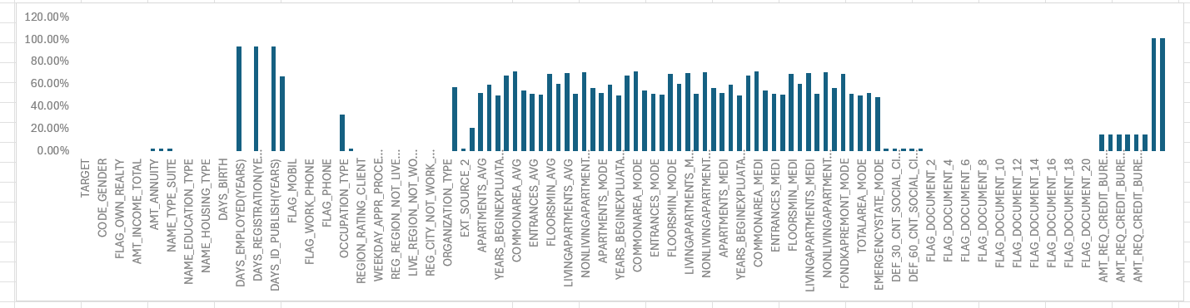
Identify Missing Data and Deal with it Appropriately
Identify the missing data in the dataset and decide on an appropriate method to deal with it using Excel built-in functions and features.
Utilize Excel functions like COUNT, ISBLANK, and IF to identify missing data. Consider using functions like AVERAGE or MEDIAN for imputation or other appropriate methods available in Excel.
Create a bar chart or column chart to visualize the proportion of missing values for each variable.

Slide 7
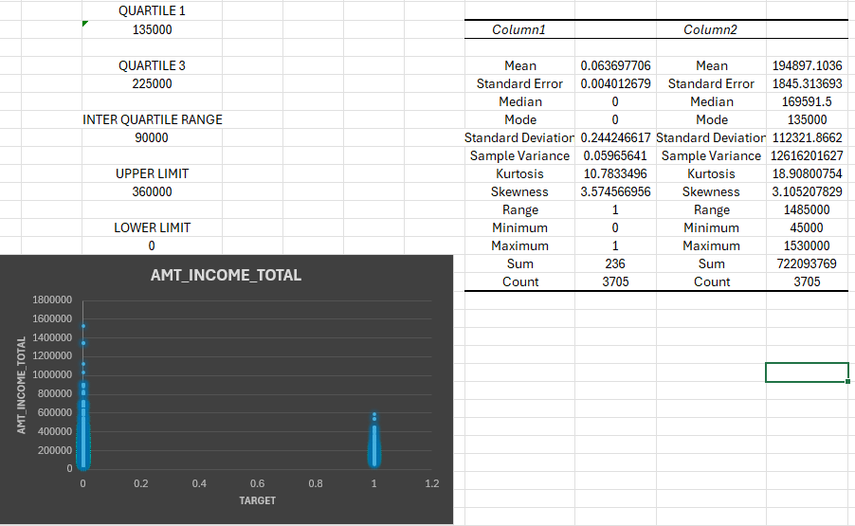
B. Identify Outliers in the dataset.
Detect and identify outliers in the dataset using Excel statistical functions and features, focusing on numerical variables.
Utilize Excel functions like QUARTILE, IQR, and conditional formatting to identify potential outliers. Consider applying thresholds or business rules to determine if the outliers are valid data points or require further investigation.
Create box plots or scatter plots to visualize the distribution of numerical variables and highlight the outliers.

Slide 8
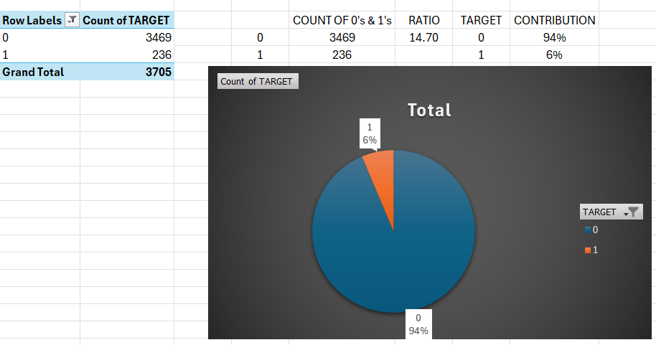
C. Analyze Data Imbalance
Determine if there is data imbalance in the loan application dataset and calculate the ratio of data imbalance using Excel functions.
Utilize Excel functions like COUNTIF and SUM to calculate the proportions of each class. Compare the class frequencies to assess data imbalance.
Create a pie chart or bar chart to visualize the distribution of the target variable and highlight the class imbalance.

Slide 9
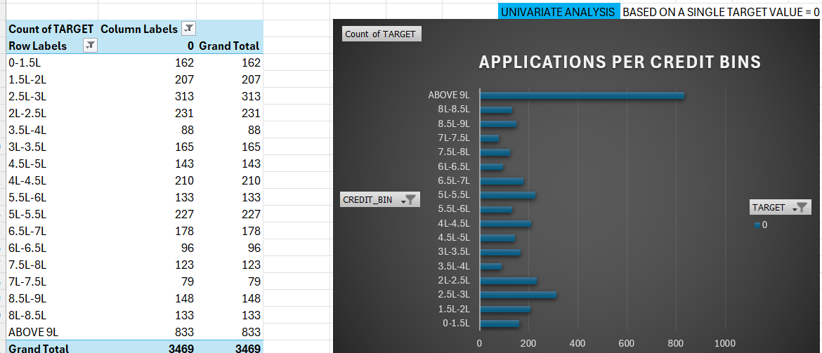
D. Perform Univariate, Segmented Univariate and Bivariate Analysis.
Perform univariate analysis to understand the distribution of individual variables, segmented univariate analysis to compare variable distributions for different scenarios, and bivariate analysis to explore relationships between variables and the target variable using Excel functions and features.
Hint: Utilize Excel functions like COUNT, AVERAGE, MEDIAN, and statistical functions for descriptive analysis. Utilize Excel features like filters, sorting, and pivot tables for segmented and bivariate analysis.

Slide 10
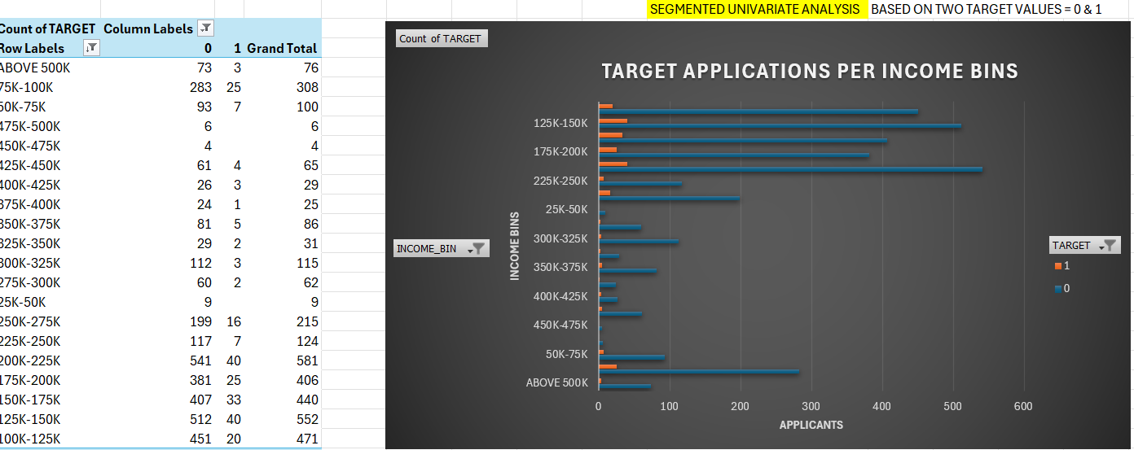
D. Perform Univariate, Segmented Univariate and Bivariate Analysis

Slide 11
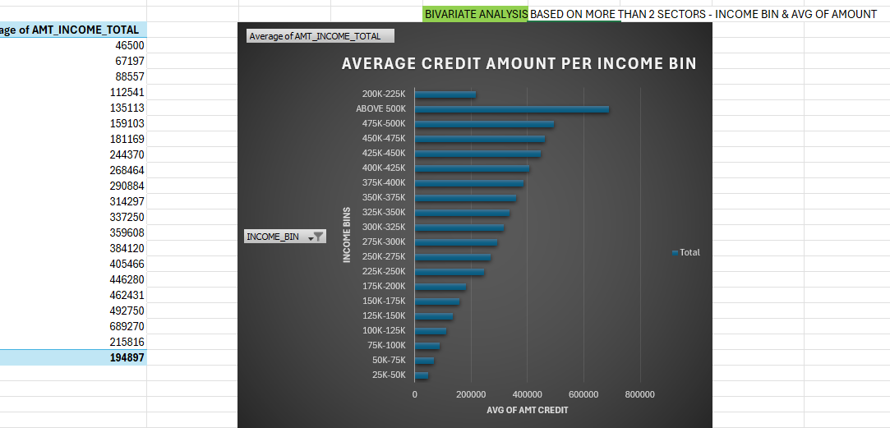
D. Perform Univariate, Segmented Univariate and Bivariate Analysis

Slide 12
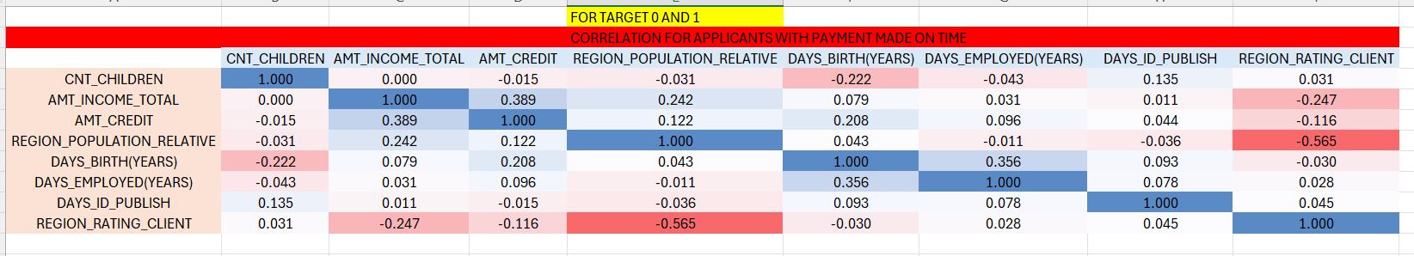
E. Identify Top Correlations for Different scenarios.
Segment the dataset based on different scenarios (e.g., clients with payment difficulties and all other cases) and identify the top correlations for each segmented data using Excel functions.
Hint: Utilize Excel functions like CORREL to calculate correlation coefficients between variables and the target variable within each segment. Rank the correlations to identify the top indicators of loan default for each scenario.

Slide 13
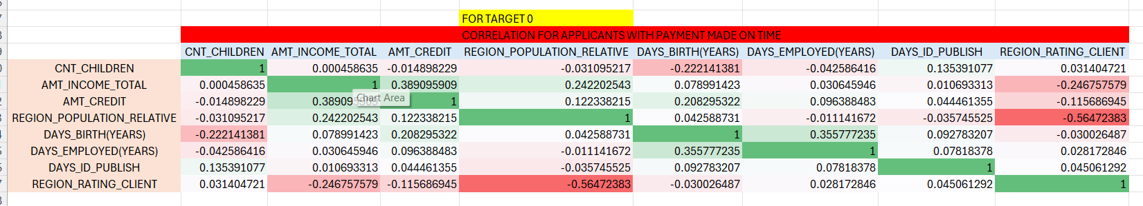
E. Identify Top Correlations for Different scenarios.

Slide 14
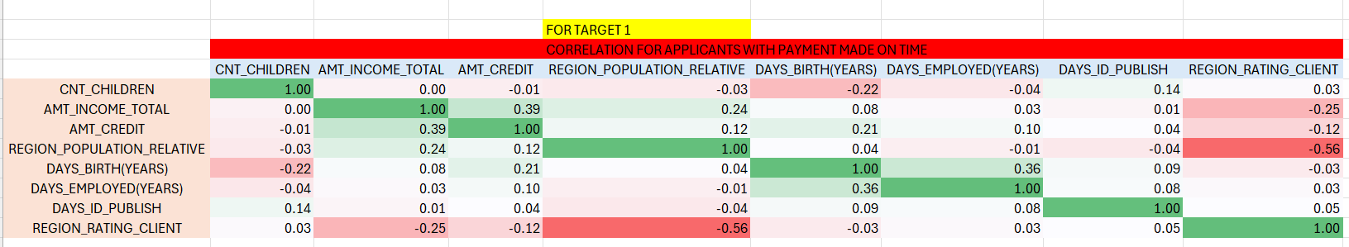
E. Identify Top Correlations for Different scenarios.

Slide 15
INSIGHTS
We clean the data , get rid of the null values , duplicate values blank cells.
Apply the knowledge of EXCEL and STATISTICS and get the desired output of all the 5 tasks that were required.
Handling the first task took the longest time and for the rest of the task time required started to decline as compared to first task.
We got all the tasks done and the knowledge of Excel increased a lot , overall it was a Very good project.

Slide 16
CONCLUSION
From the above analysis, we can find out what kind of people can repay loan, what kinds of loan people taking loans coming from what background, what is the source of income, for what type of people, the loan the applications are refused and based on which conditions.
RESULTS:-
1. People with academic degree have less defaults. 2. People prefer cash loans more than any other type. 3. People with secondary/secondary special as education type have more chances of defaulting loans. 4. People who have less than 5 years of employment have high default rate. 5. Focused variable for application file – Target. 6. Focused variable for Previous application file – NAME_CONTRACT_STATUS. 7. Important fields to consider for loan repayment are – 8. NAME_EDUCATION_TYPE 9. AMT_INCOME_TOTAL 10. DAYS_EMPLOYED 11. AMT_CREDIT 12. People with lower total income are more likely to default. 13. People with high Credit amount are less likely to default.
EXCEL LINK
GOOGLE DRIVE LINK

Slide 17
THANK YOU.

